Slide 1





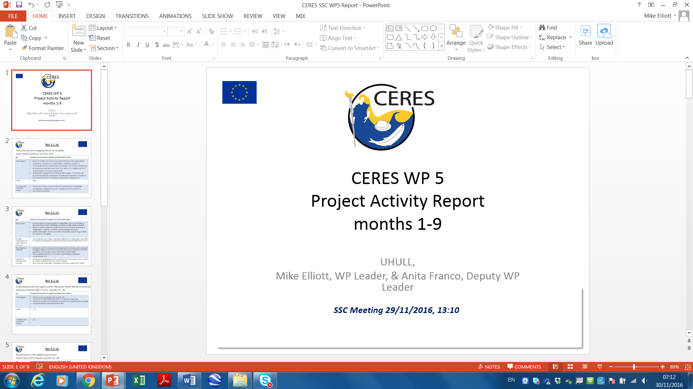
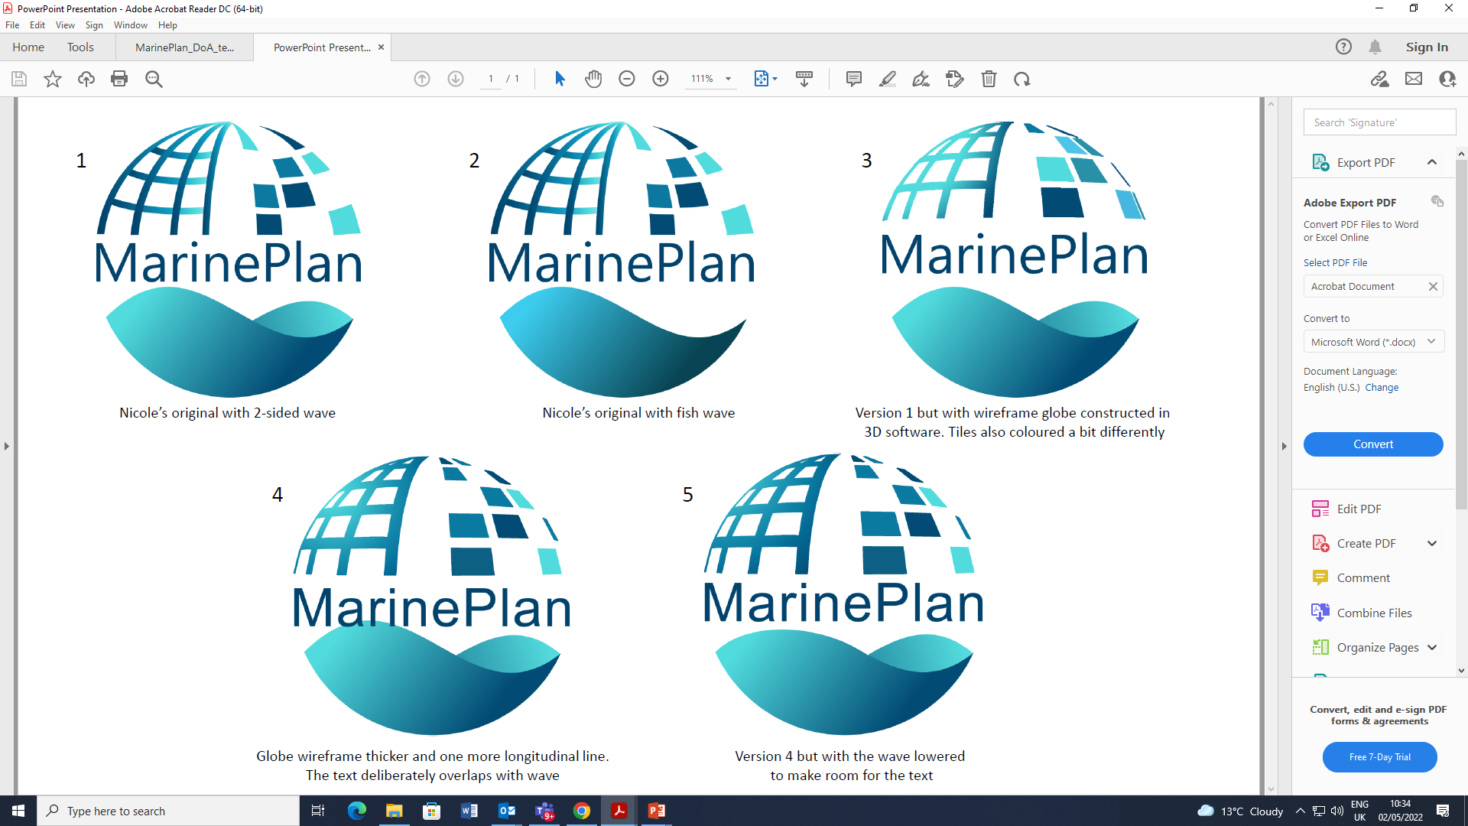
Marine and Estuarine Risk and Opportunity Assessment and Management – Tools to Satisfy Nature, Industry and Regulators
Mike Elliott^{1,2} & Roland Cormier³
1. Department of Biological & Marine Sciences, University of Hull, Hull, HU6 7RX, UK;
2. International Estuarine & Coastal Specialists (IECS) Ltd, Leven, HU17 5LQ, UK.
3. Helmholtz-Zentrum Geesthacht, Institute for Coastal Research, Max-Planck-Straße 1, 21502 Geesthacht, Germany
Marine SABRES

Slide 2
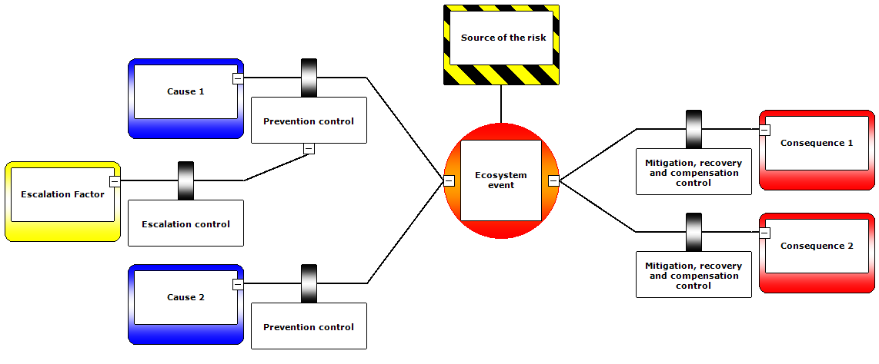
Bow-tie Analysis – modelling risk assessment & risk management
D, A, P
R(M)
R(M)
S, I(W)
S, I(W)
(Cormier et al., 2019, Sci. Tot. Env.)
Stakeholder consultation – to determine causes and consequences and to agree the responses throughout the sequence

Slide 3
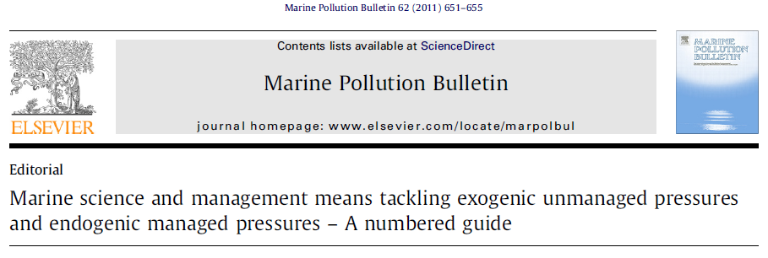
The 10 tenets:
To be successful, management measures or responses to changes resulting from human activities should be:
Ecologically sustainable
Technologically feasible
Economically viable
Socially desirable/tolerable
Legally permissible
Administratively achievable
Politically expedient
Ethically defensible (morally correct)
Culturally inclusive
Effectively communicable
(cf. PESTLE)

Slide 4
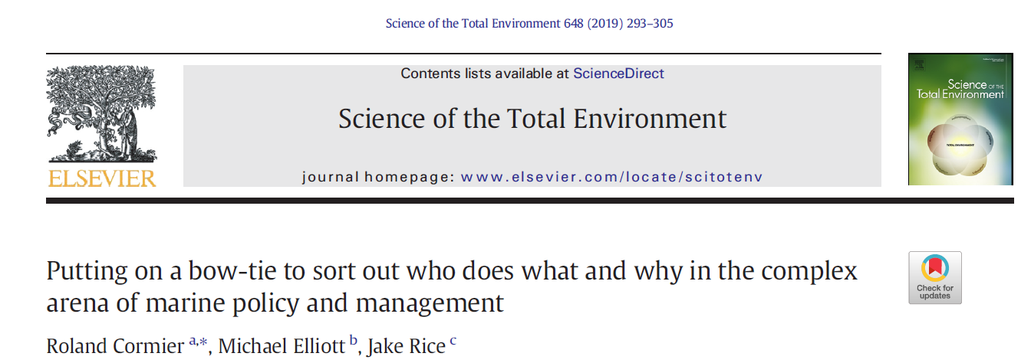
Bow-Tie Analysis linked to DAPSI(W)R(M) Framework for Risk Assessment and Risk Management (Drivers, Activities, Pressures (as mechanisms of change), State change (on the natural system), Impact (on human Welfare), Responses (using Measures based on 10-tenets – econ., tech, ecol., legal, admin, cult., polit., moral, comm., social aspects)
Bow-tie in a nutshell:
What is the problem I am worrying about?
What are the causes?
What are the prevention mechanisms?
What are the mitigation /compensation measures?
What are the consequences?

Slide 5
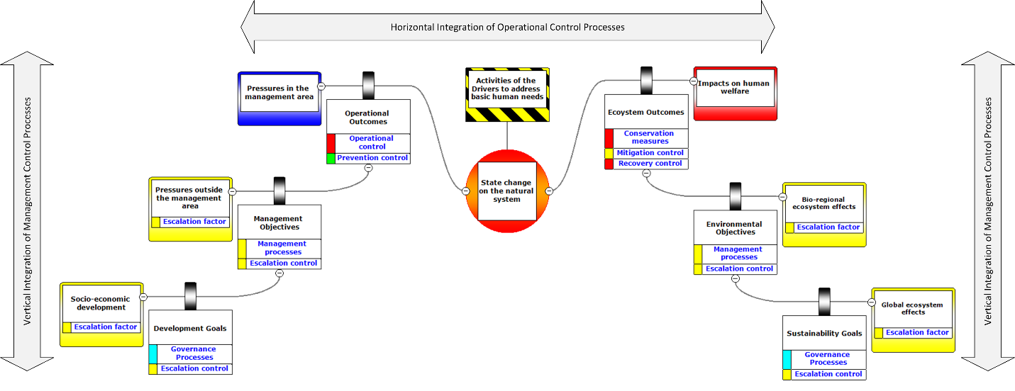
Bow-tie Analysis as a Problem-Structuring Method
CERES is the first attempt to use BT analysis for climate change repercussions for fisheries and aquaculture

Slide 6
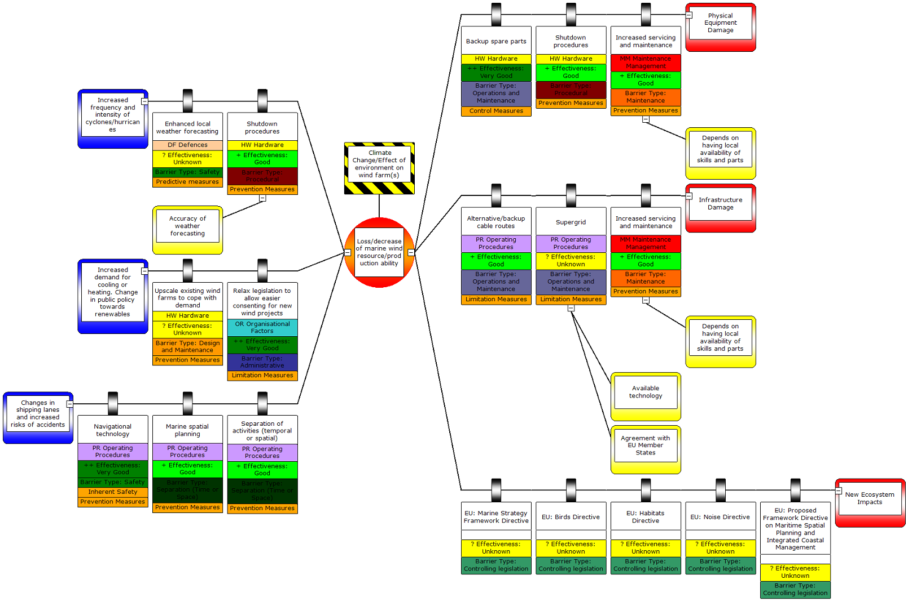
Bow-tie for climate change effects on OWF
(See also Burdon et al. 2018. Est. Coast. Shelf Sci. 201: 234-247)

Slide 7
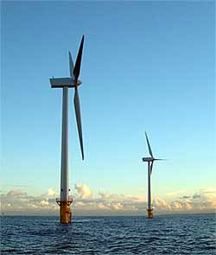
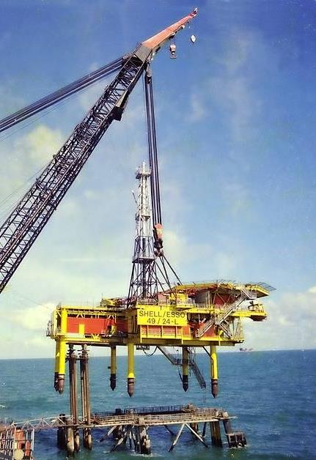
As examples, the central event in the Bow-tie could be:
Environmental consequences of construction, operation and/or decommissioning techniques
Economic costs or benefits of different technologies
Environmental consequences of climate change on the structures
Enhanced climate change adaptation and mitigation
Influence on other marine uses and users
Economic benefits of adaptation techniques

Slide 8
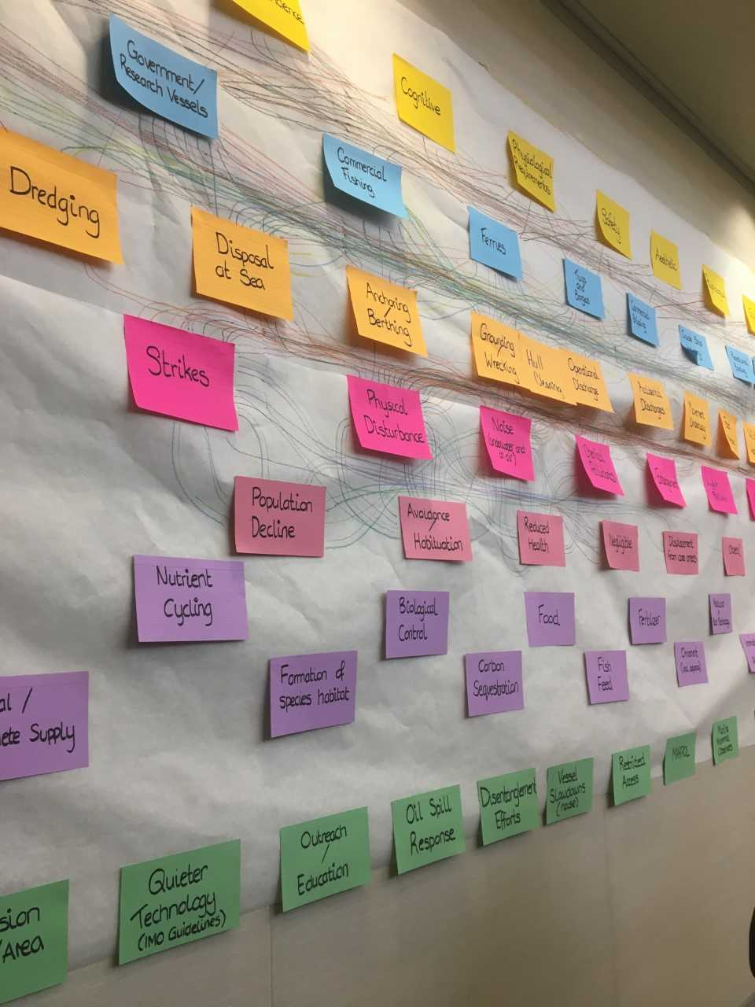
Framework for tackling the problem and identifying opportunities:
Define the central problem and the framework for opportunities
Create risk- and opportunity-based generic Bow-ties with Drivers and Activities
Analyse previous experience, projects and literature
Incorporate the 10-tenets for management responses
Produce a ‘strawman’ for discussion with stakeholders
Refine and produce the site- and topic-specific Bow-ties
Interrogate Bow-Ties to show the gaps and opportunities for nature and society
Interrogate Bow-Ties to show the gaps and opportunities for science and management
(Photo. Lauren McWhinnie, UVIC workshop, 2018)

Slide 9

Mussels – Aquaculture
Climate change itself is beyond short/medium term control. Control and mitigation measures given here focus instead on measures that could be adopted my local producers and fishers, rather then attempting to modify global climate change.
Causes (blue)
Control measures (green)
Escalation factors (grey)
Problem (yellow)
Mitigation measures (green)
Escalation factors (grey)
Consequences (red)
Increased temperature
Harmful Algal Blooms
Capital costs
Lack of financing options
Increased production costs
Higher market prices
Hypoxia
High Impact
Ocean acidification
Pathogens and parasites
Critical impact
Competition from other markets/areas
5
Increased storminess
6
Lower market sizes of mussels
Decreased Profits
Changes in reproductive success
Changes to survival, health and fitness and growth and food webs
8
11
Season changes
10
1, 7
Damage to aquaculture infrastructure
Prey availability
12
Decreased viability of operation
9
12
a,b,c
d
e
f
1, 7
11
Medium impact
Other physico chemical water changes
10
5
3
13
Water quality
4
Losses and/or mortality mussels
Space constraints
Strong Impact
3
1
7
Other hydrodynamic changes
Reduced employment
Competition with non native species
Some areas only allow production of bivalves or seaweeds
Some areas only allow production of bivalves or seaweeds
5
9
10
Changes in physiological tolerance
11
Decreased temperature
13
a,b,c
Capital costs
Lack of financing options
Impact on traditions and values
Small Impact
NON DIRECT CLIMATE RELATED problems
Bio toxins (DSP, PSP, ASP) increasing levels
Sea current changes, wind current changes
a,b,c
Low impact
Increased droughts
Costs for adaptations of gear or operations
Key to control and mitigation measures
The key is very large due to good stakeholder participation for this storyline, so is given in the box to the left side (please exit presentation view for this) and is also given on the next slide
Sea level rise
Notes:
5/5 participants said their answers were based on belief/experience, 2/5 said they would be willing to share their experience/expertise with CERES.
The same 2/5 said their answers were also based on data/evidence and they would be willing to share their data or results with CERES.
All rankings in this analysis are given by the questionnaire participants.
One participant commented “the occurrence of upwelling is the essential for productivity in the area as there are no river in there area that might contribute with discharges of nutrients into coastal area. the area is only affected by occasional rains. when long periods of relaxation of upwelling occur means increased temperature high water transparency and reduced food availability.”
One participant commented: “due to climate change and shifts on occurrence on upwelling therefore reduced chlorophyll, might need to allow to farm fish.”
No EU legislation was thought to negatively influence the exploitation of the mussels, however local Portuguese legislation was considered detrimental: too much bureaucracy and slow. Legislation not adapted to farmers reality.
Immediate problems for the industry: Incidence of Harmful Algal Blooms (HABS), reduction of water quality, changes in wind currents, sea currents and therefore water temperature, competition and monopolization, staff recruitment and lack of knowledge of industry by available workers.
Mid term problems for the industry (5-10 years): Greater incidence of Harmful Algal Blooms, reduction of water quality
Long term problems for the industry (next decades): Greater incidence of Harmful Algal Blooms, interspecific competition with exotic species, reduction in water quality

Slide 10
(Ack. John Icely, Algarve)
Key to control and mitigation measures
Ranked High
Catch and release: promote the catch and release of endangered native species
Control trade in marine species: control and punish the trade of endangered native species
Stock management: Larger investment in maintaining existing stocks
Fisheries management: Increasing the open season and the quotas to be considered.
Technology: very important to adapt technologies for the site characteristics.
Ranked Medium
EU legislation: Cheaper insurances for losses
Stock enhancement programs: programmes oriented to enhance mussel seed settlement and recruitment
Local legislation: Investment in more effective control of production and sales and updating of aquaculture law
Habitat management: increasing the area destined for mussel seed collection and mussel settlement structures
Ranked Low
Government incentives: More investment in government vet/climate agencies
Technology: more research oriented to improve harvesting techniques and cultivation structures
Government incentives: Subsidies to buy seed
Promote alternative resources: control exotic species to decrease the interspecific competition
No ranking given
Local legislation: allow to farm other species not currently allowed
Local legislation: less restrictions in farming practices
Promote alterative resources: look for the most suitable species for the sites
Government incentives: reduce the taxes and fees on farming. incentives on diversification of species and products
Promote alternative resources: Increase “gastronomic” tourism or other nautical/climate tourism activities
Promote alternative resources: explore new commercial markets

